Slide 1



Global air pollution modelling
University of Utrecht, The Netherlands
Global and geo-health data center
Meng Lu

Slide 2
Overview
Introduction
Spatio-temporal epidemiology
Air pollution modelling and exposure assessment for health research
Global air pollution modelling

Slide 3
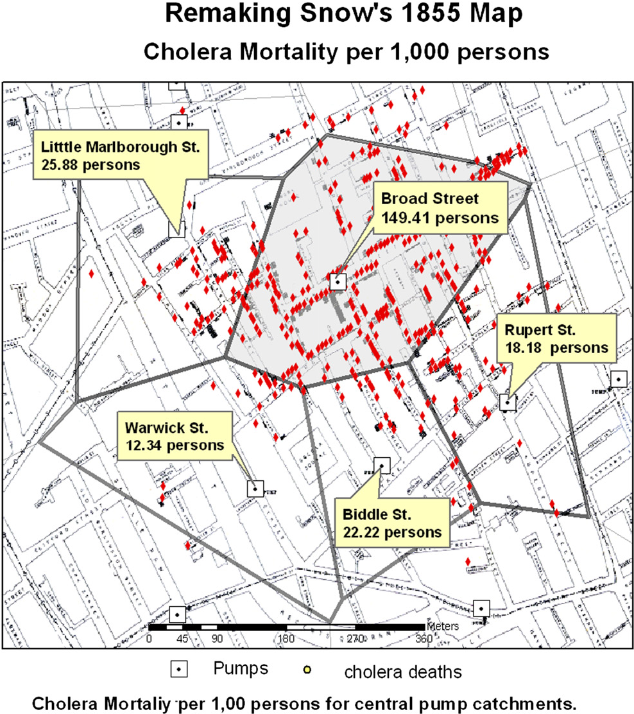
Spatio-temporal Epidemiology
Spatiotemporal epidemiology: The description and analysis of geographical data, specifically health outcome data and factors that may explain variations in these outcome data over space. factors: environmental, demographic, genetic, habits, infectious risk factors.
Environmental epidemiology: Spatiotemporal epidemiology that focuses on how environmental exposures impact human health.
Origin
1854 John Snow,
Identify possible causes of cholera outbreaks.

Slide 4


Slide 5

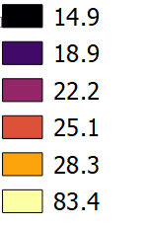
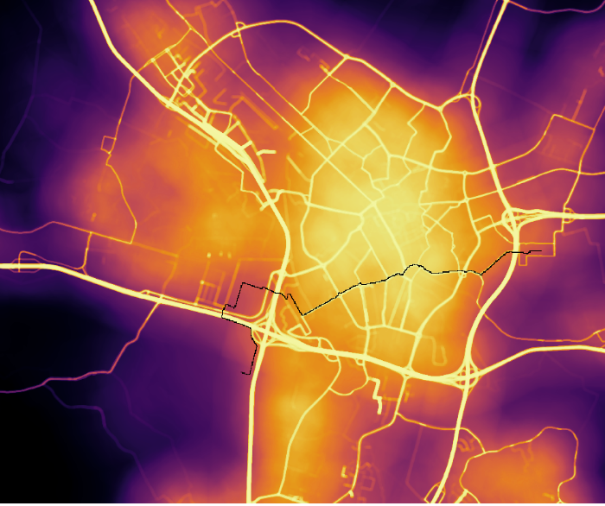
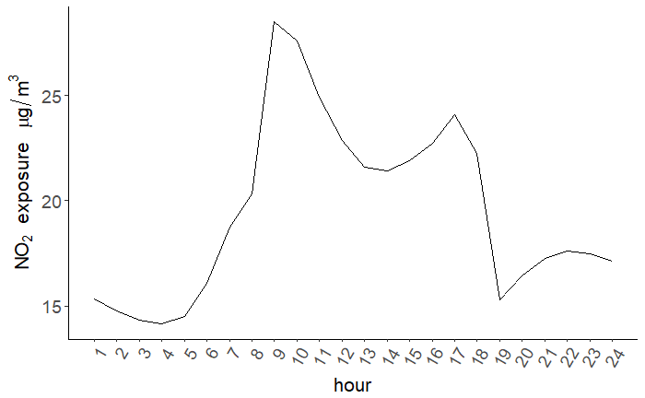
Exposome
Link environment to health:
Agent-based modelling approach
weekdays | 00:00 - 08:00 08:00 - 09:00 08:10 - 17:00 17:00 - 18:00 17:09 - 23:59 | home commuting work commuting home
Challenge: detailed space-time paths over a large population and long time period may not be available.
work

Slide 6

Take a deep breath

Slide 7
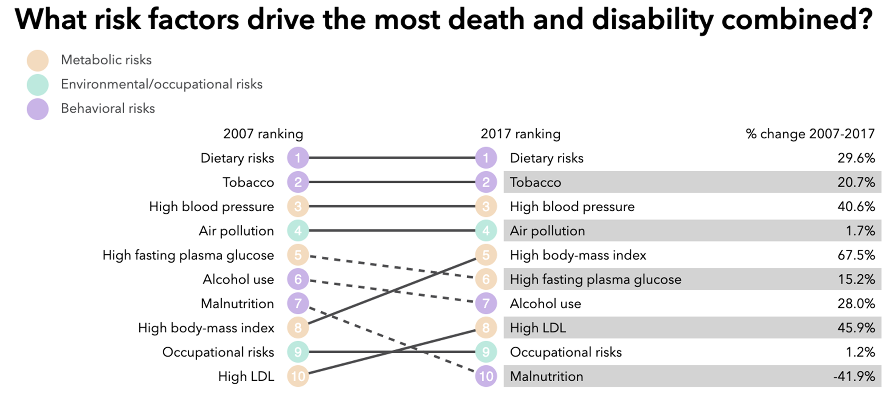
Air pollution -- Consists of chemicals or particles in the atmosphere that poses health and environmental threats.
Mortality:
World: more than 3.2 8.8 millions death a year

Slide 8
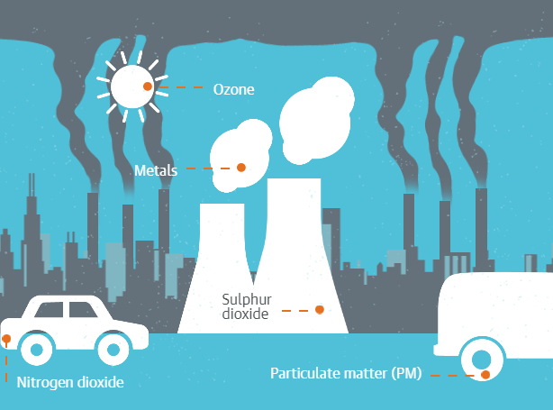
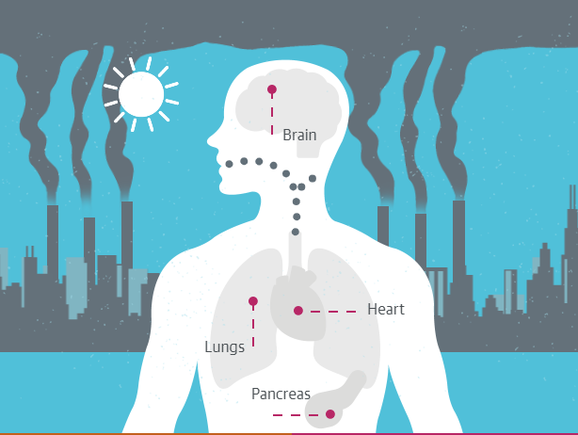
Most measured air pollutants and their health impacts O3 NO2 SO2 CO PMx Little is known about how air pollutant affect health over a population
Source [2]

Slide 9
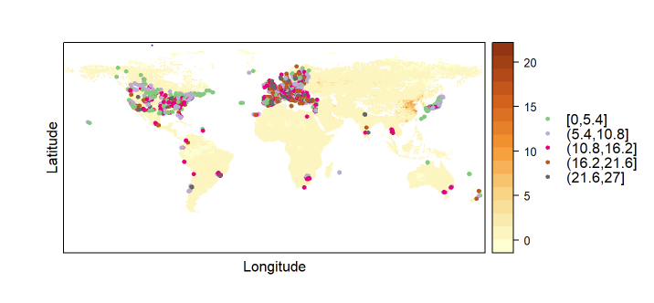
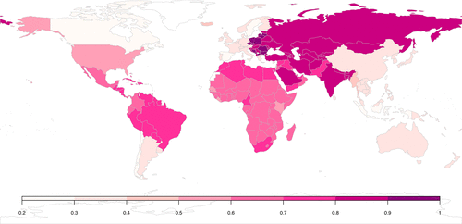
Why is global air pollutant mapping and exposure assessment important?
Unequally distributed ground monitors
Consistent comparison
Station measurements
Shaddock et al., 2018

Slide 10
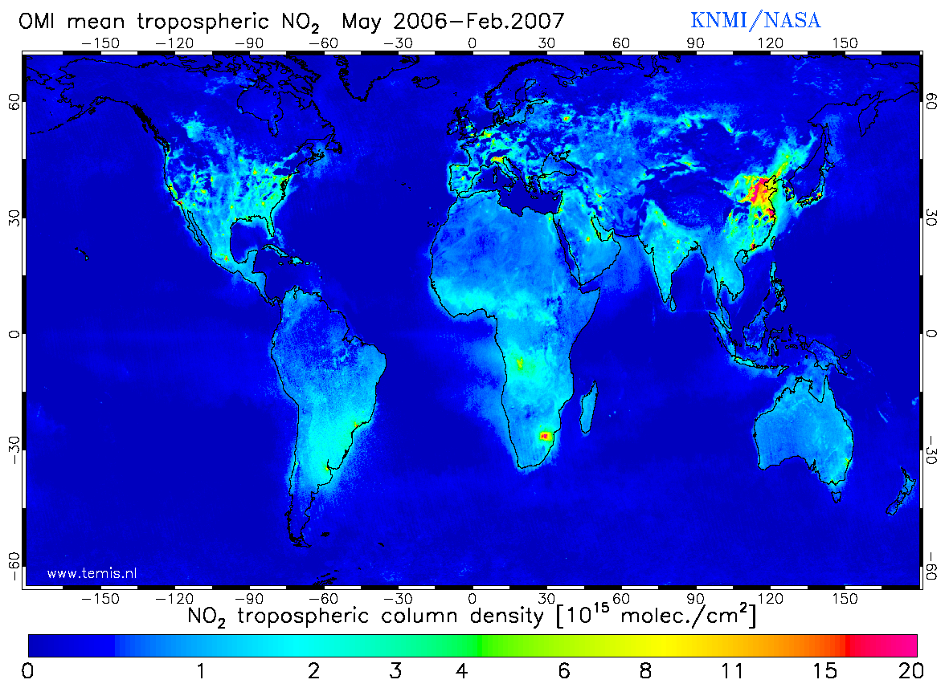
Remote sensing measurements: OMI (Ozone Monitoring Instrument)
Date of Launch | 15 July 2004
At nadir 13 km × 24 km
NO2, SO2, BrO, OCIO, O3 (36 km × 48 km)
Spectral bands: ultraviolet and visible (270 to 500 nm)
Zoom in mode 13 km× 12 km
Daily global coverage

Slide 11
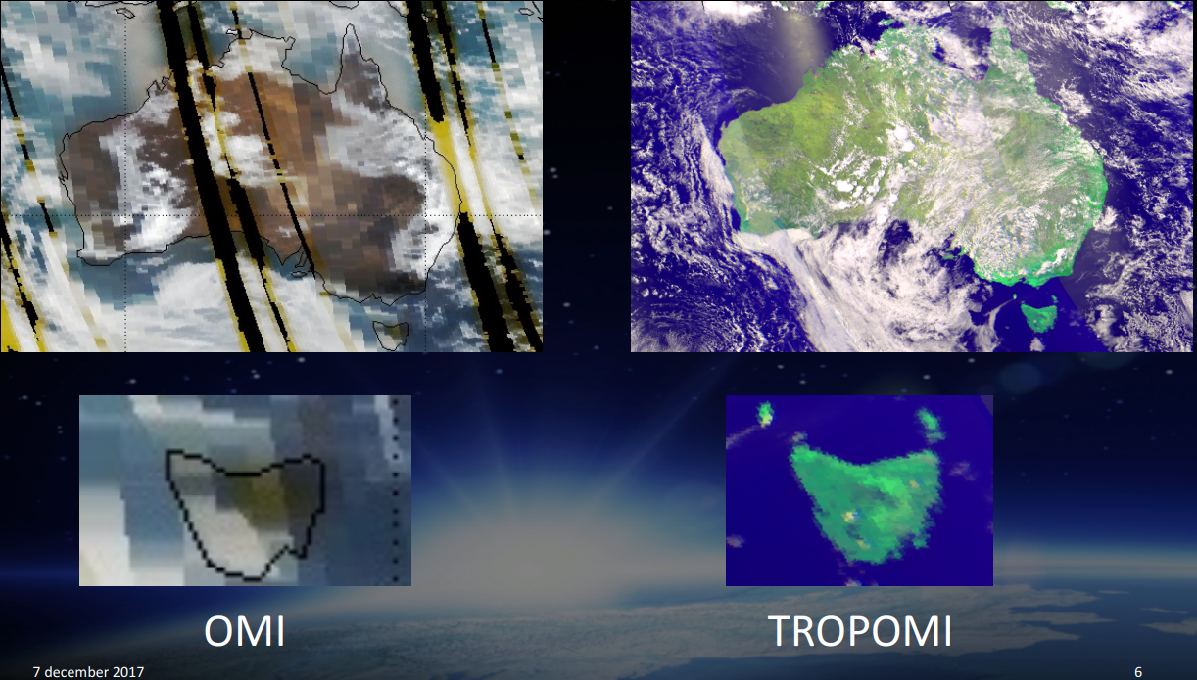
Tropomi
(TROPOspheric Monitoring Instrument)
launched 2017, available from Feb 2018
7 km x 7 km
Souce [3]

Slide 12

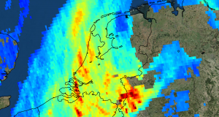
Tropomi
NO2, O3 (7km × 28km), SO2, methane and CO
Spectral bands:
ultraviolet and visible (270–500 nm), near-infrared (675–775 nm), shortwave infrared (2305–2385 nm) spectral bands.
zoom in mode: 7 km × 3.5 km

Slide 13
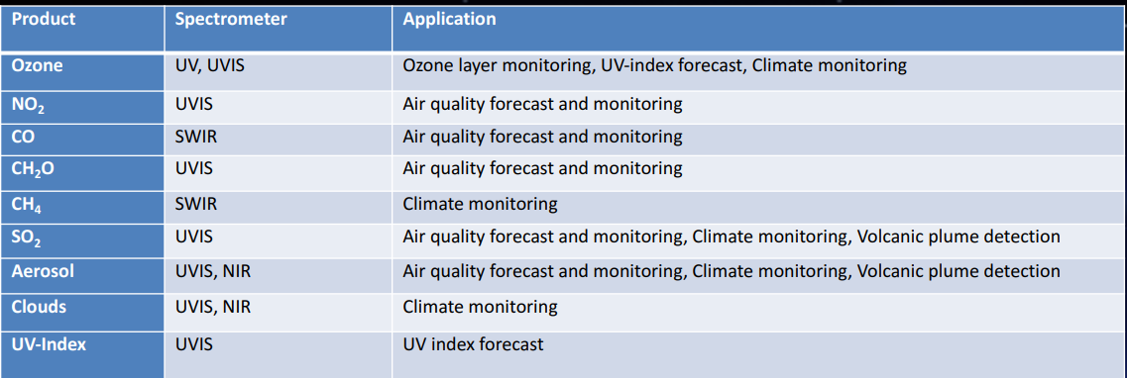
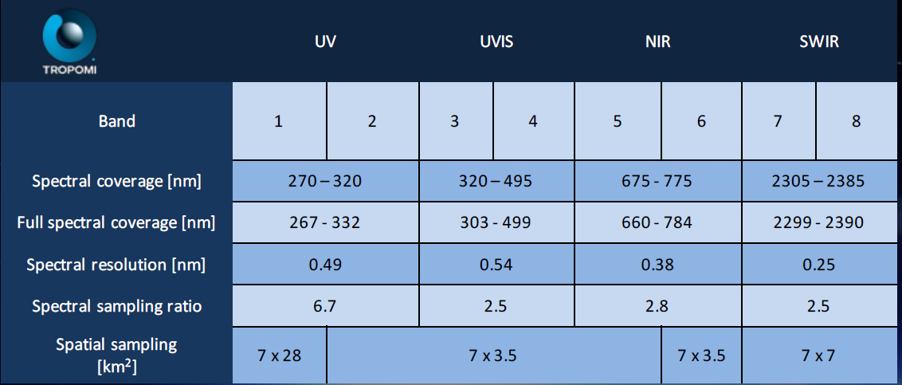
Spectral bands of Tropomi

Slide 14
Air pollution modelling methods
Statistical methods: regression, Kriging
Chemical transportation models: GEOS-CHEM
Hybrid: Kalman filter

Slide 15
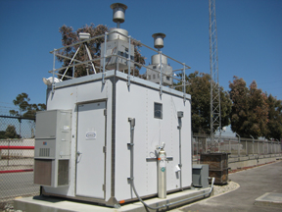
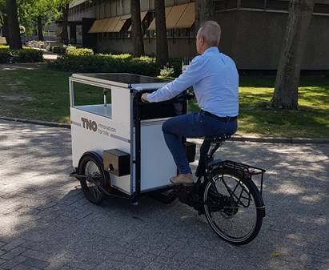
Predicting air pollution and analyzing the sources.
Land use regression (LUR)
$$y=β0+β1x1+β2x2+⋯+βnxn$$
Sensor measurements:
Station measurements
Mobil sensors
Remote sensing measurements:
OMI (250 km)
Tropomi (8 km)
…
GIS predictors:
Population
Road length within a buffer
Distance to roads
Traffic load
…

Slide 16
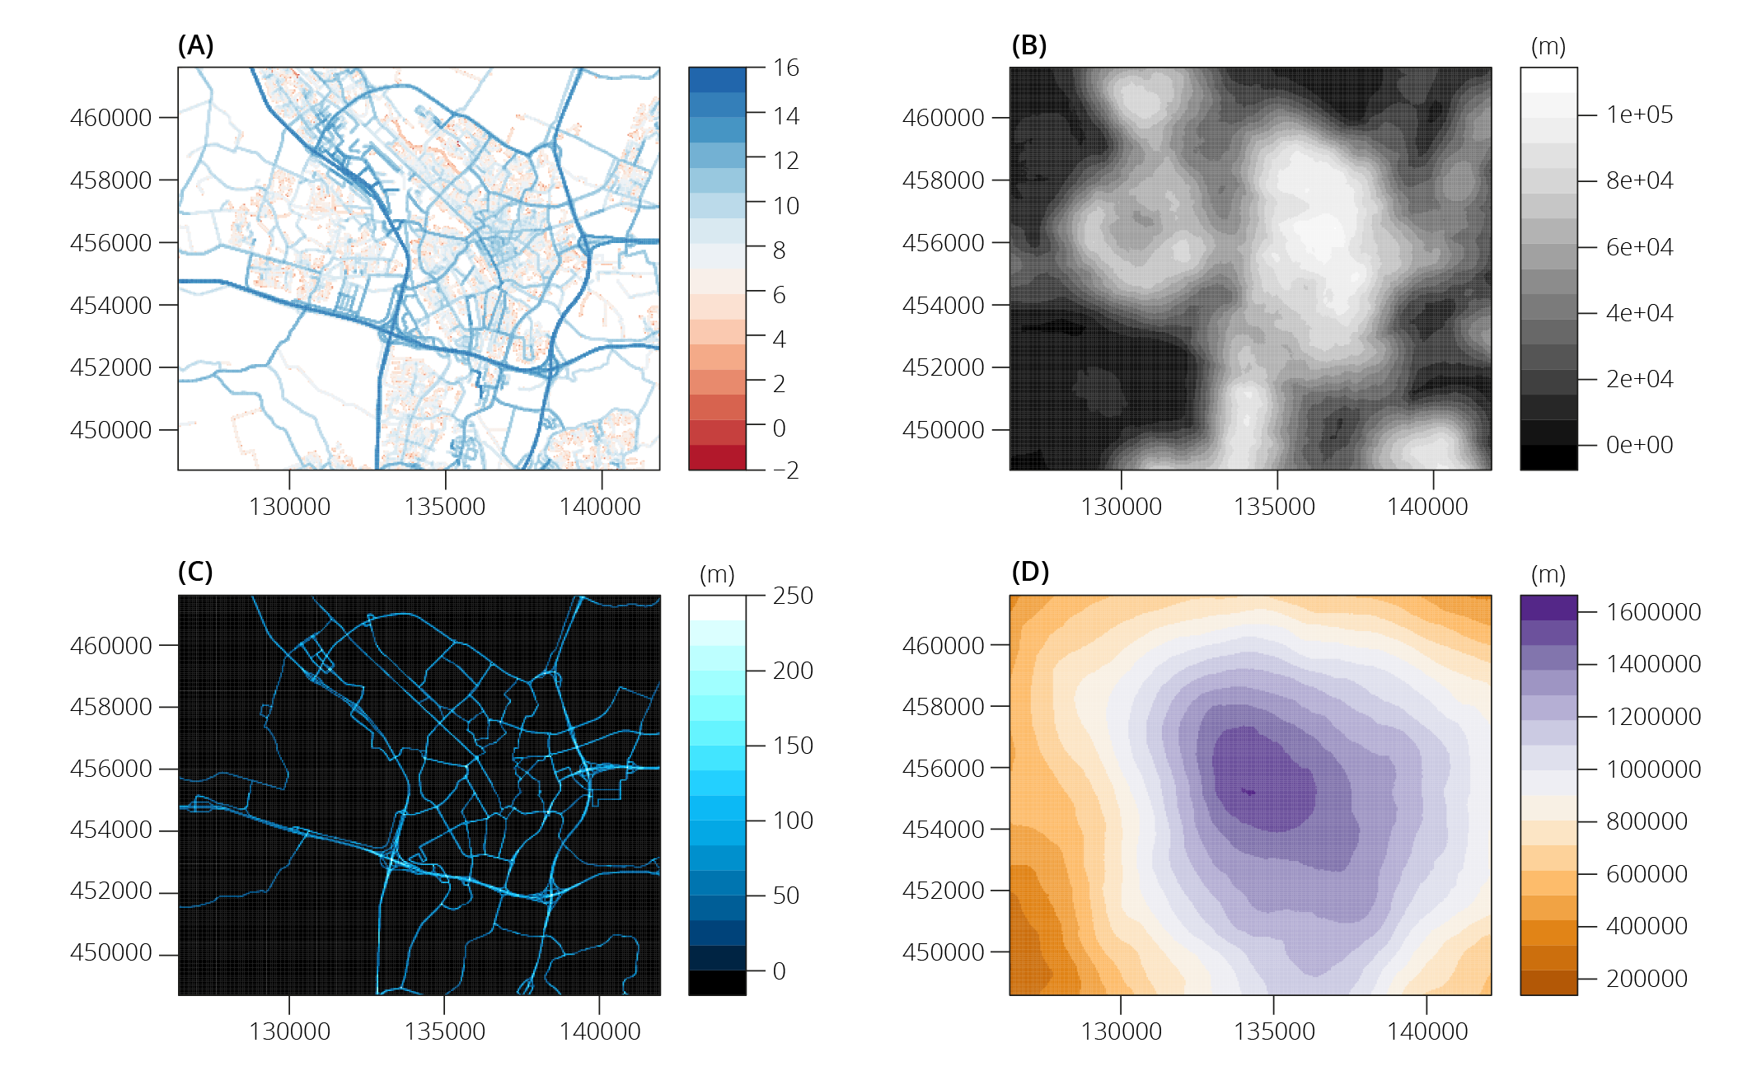

Predictor variables in buffers
Major road length
25m buffer
1000m buffer
Notes:
x

Slide 17
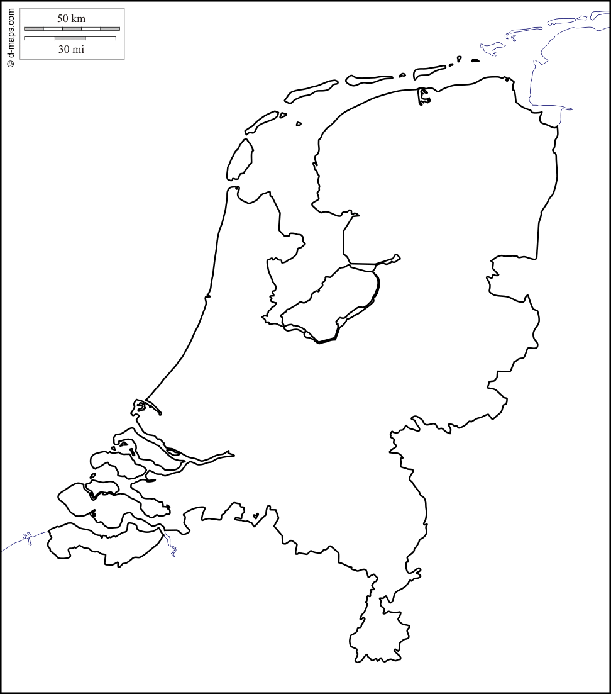
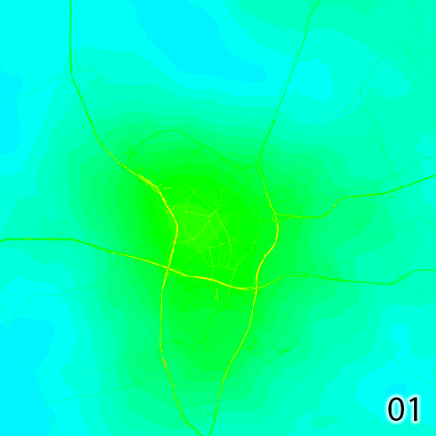

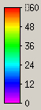
LUR Prediction
Spatiotemporal dynamic of air pollution showing road effects
60
30
0
0
5km
Hour
5 m resolution

Slide 18
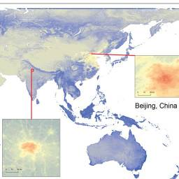
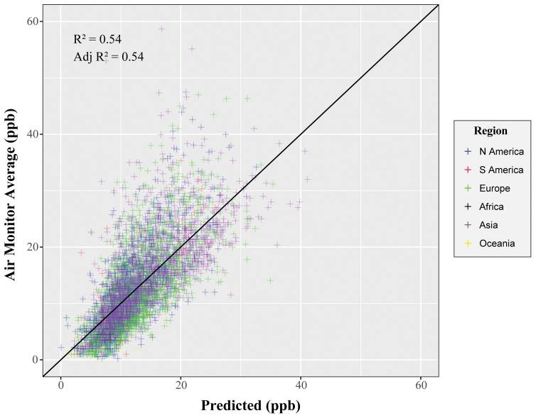
Global NO2 mapping: Larken et al. 2017 (100m):
LUR model
Lasso, continental variable as prediction
Limitations:
Linear relationship
Road effects not modelled
Only evaluated by Rsquared and RMSE
Does not include RS measurement

Slide 19
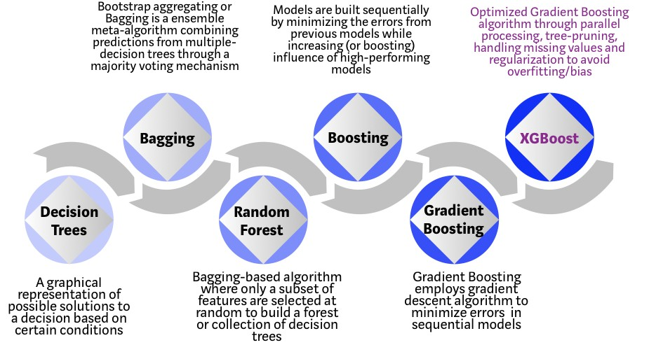
Can tree-based machine learning methods and Tropomi improve global NO2 mapping ?

Slide 20
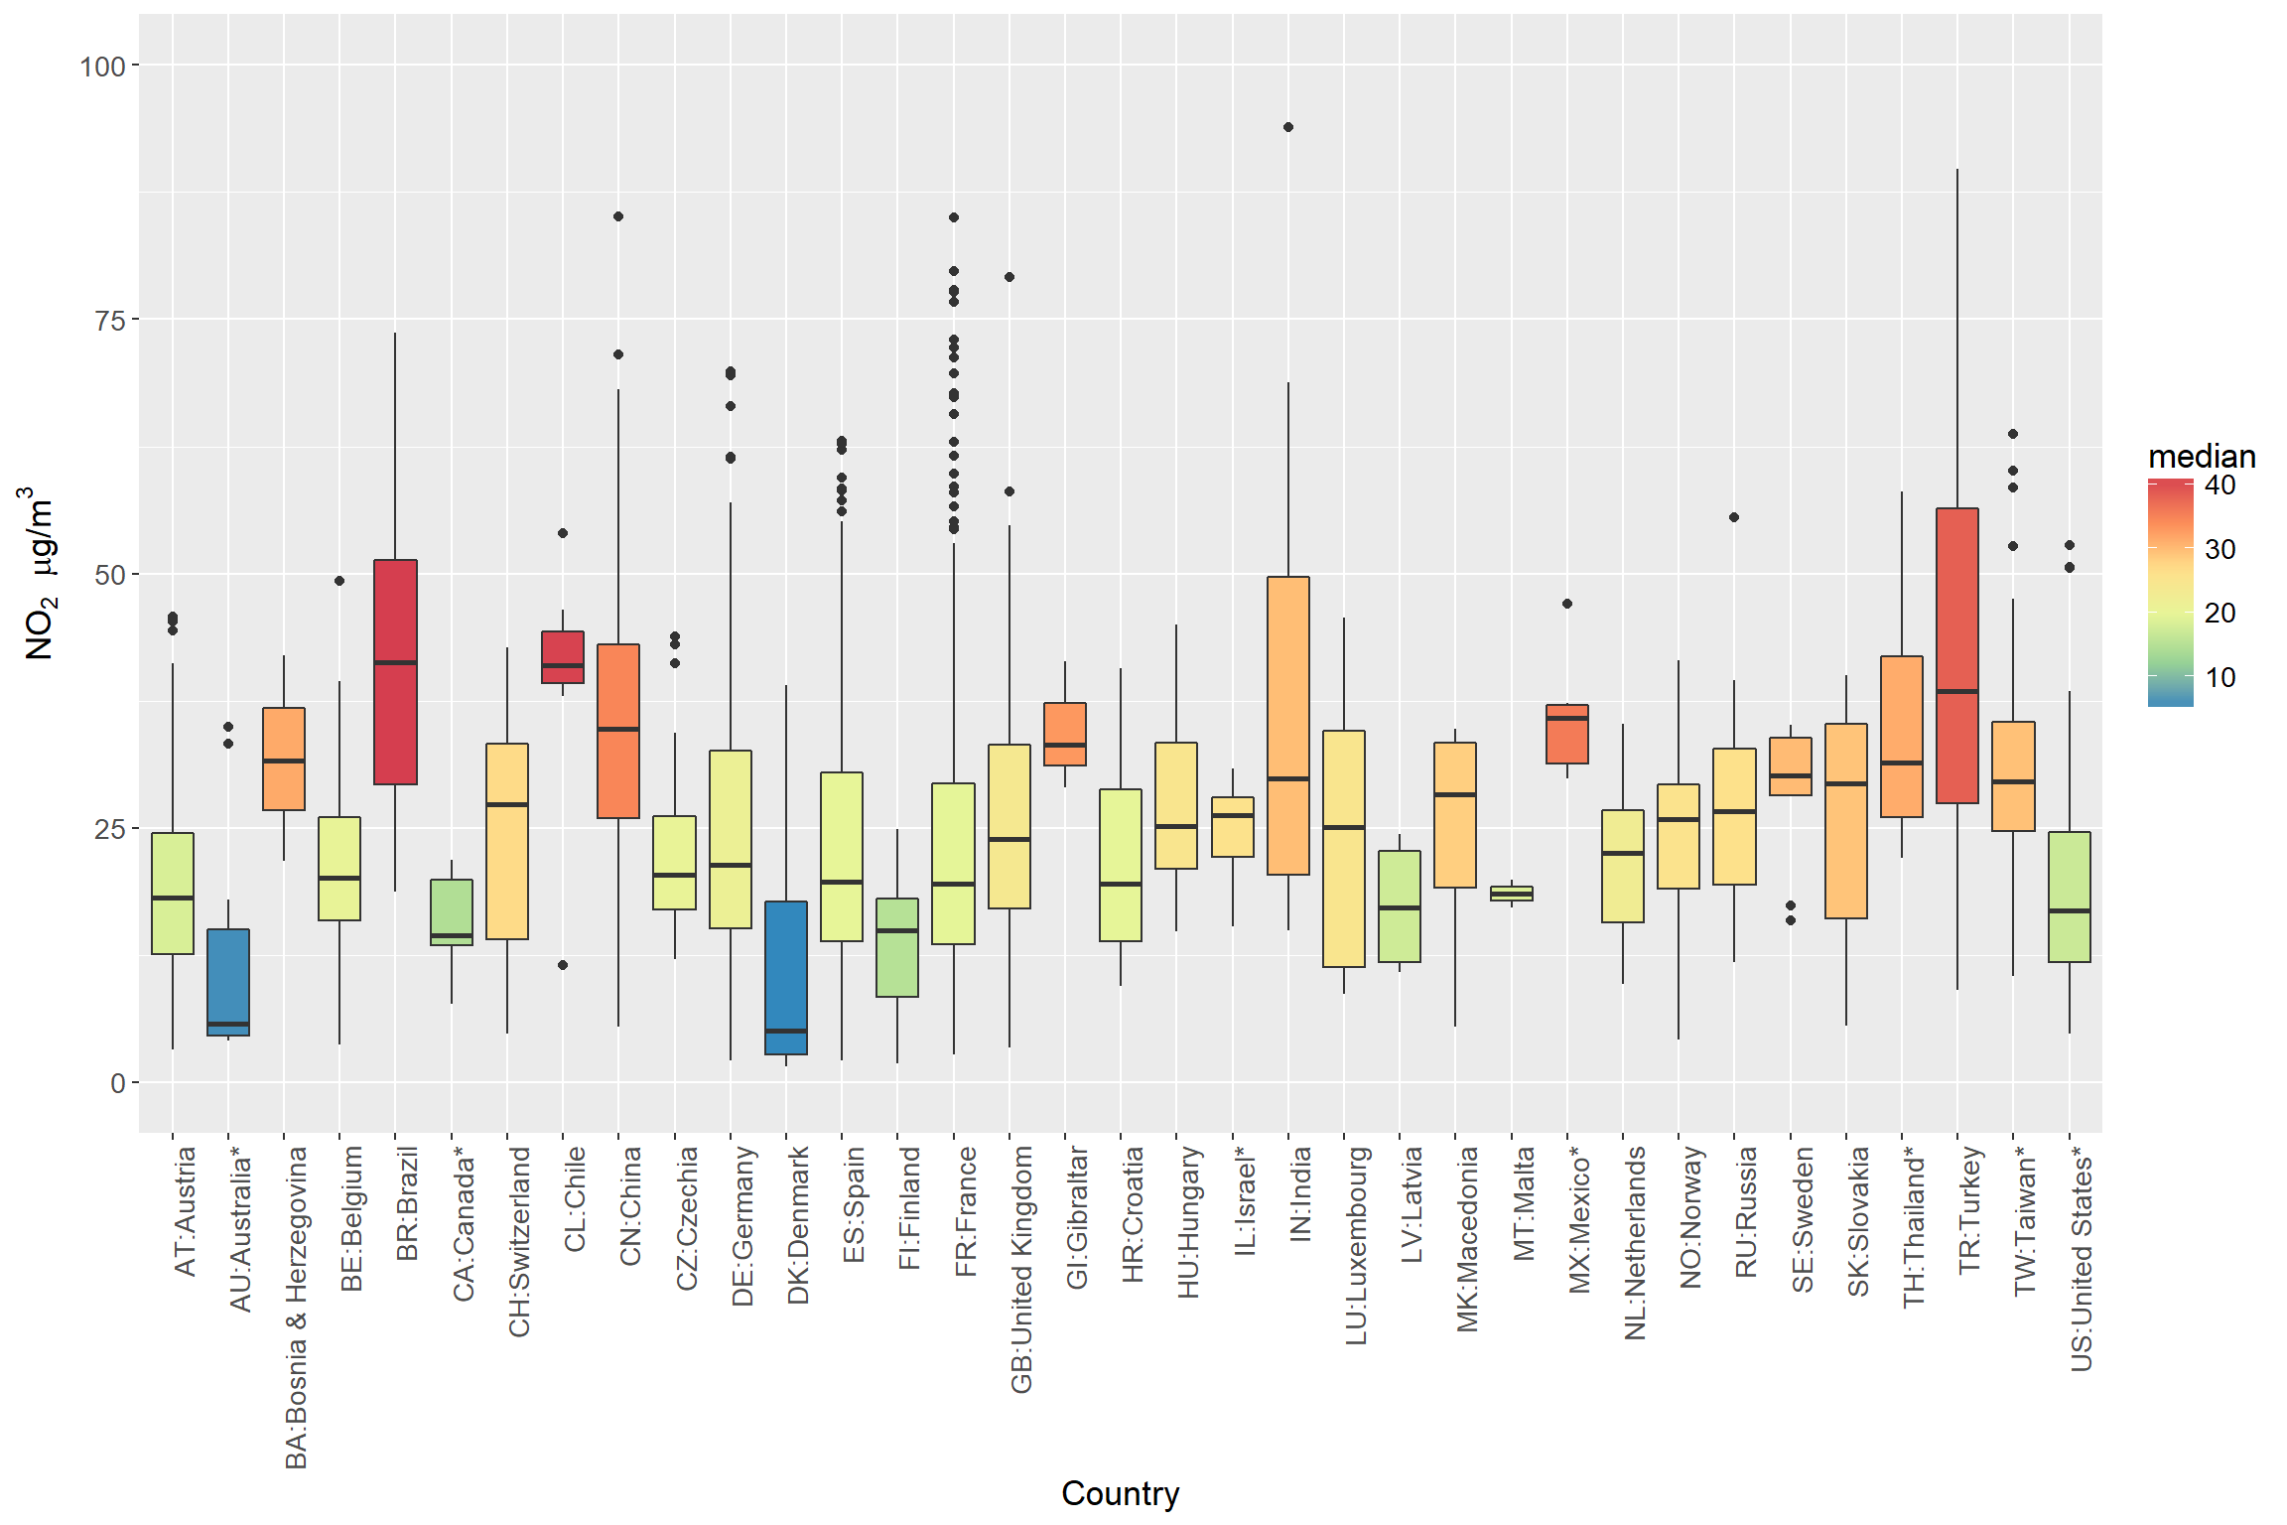
Data: OpenAQ

Slide 21
Predictors
Emission-related
Road length within 25 m – 300 m radius ring
- Highway, primary roads, secondary roads, tertiary roads, unpaved roads
Industry area within 25 m – 300 m radius ring
Background
Road length within 300 m - 5000 m radius ring
Population: 1 km, 3 km, 5 km
Industry area 300m - 5km
Monthly wind speed (0.5 degree)
Monthly temperature (0.5 degree)
Surface concentration from Satellite products and the GEOS-CHEM
Satellite measured NO2 column density
Distance to coast

Slide 22
Method
Comparing different statistical learning methods
Compare global and national models
Trees-based
Four national models:
US (100),
China (1400),
Germany (350),
Spain (350)
A global model
- Random forest
Stochastic gradient boosting
Extreme gradient bossting
Regularized regression
Ridge
Lasso
ElasticNet
Mechamical model
- Nonlinear regression integrating air distribution mechanisms

Slide 23
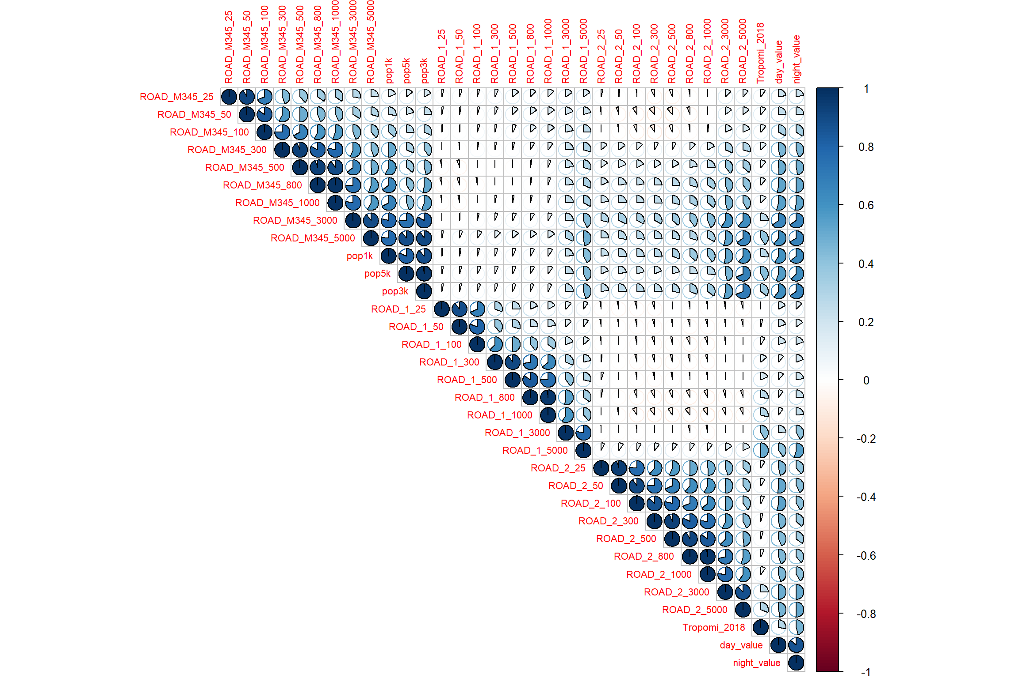
Data
Local roads
Primary roads
Paired correlation: separating between day and night
Tropomi
germany

Slide 24
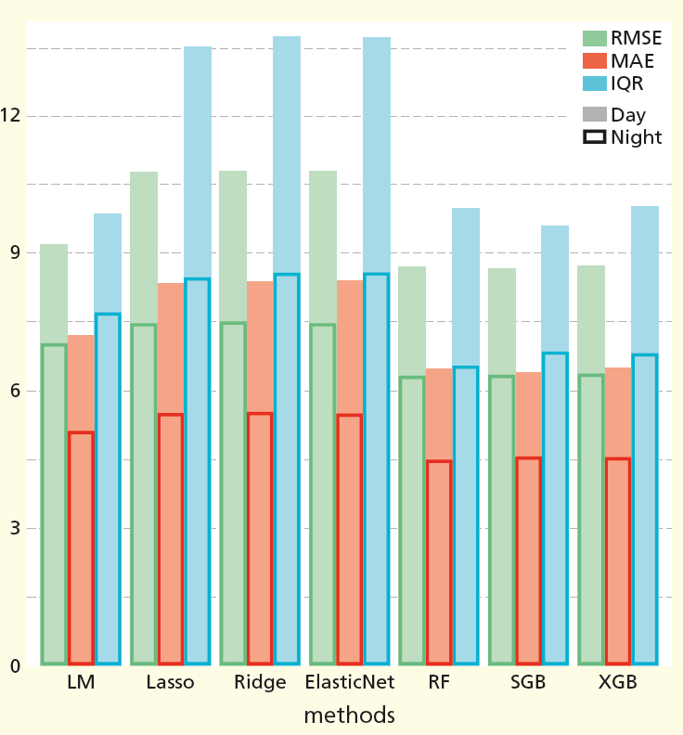
Result: global model accuracy
RMSE: root mean squared error
MAE: mean absolute error
IQR: interquartile range
LM: Multiple linear regression
RF: random forest
SGB: Stochastic gradient boosting
XGB: xgboost

Slide 25
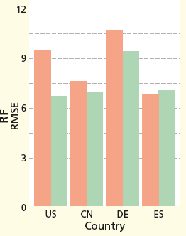
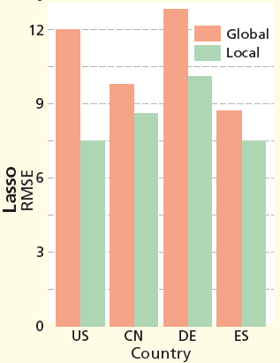
Result: global and national models
RF vs. Lasso
CN: China
DE: Germany
ES: Spain
Conclusion: random forest is more suitable than Lasso for a global NO2 maping and using random forest can achieve an accuracy as good as national models.

Slide 26
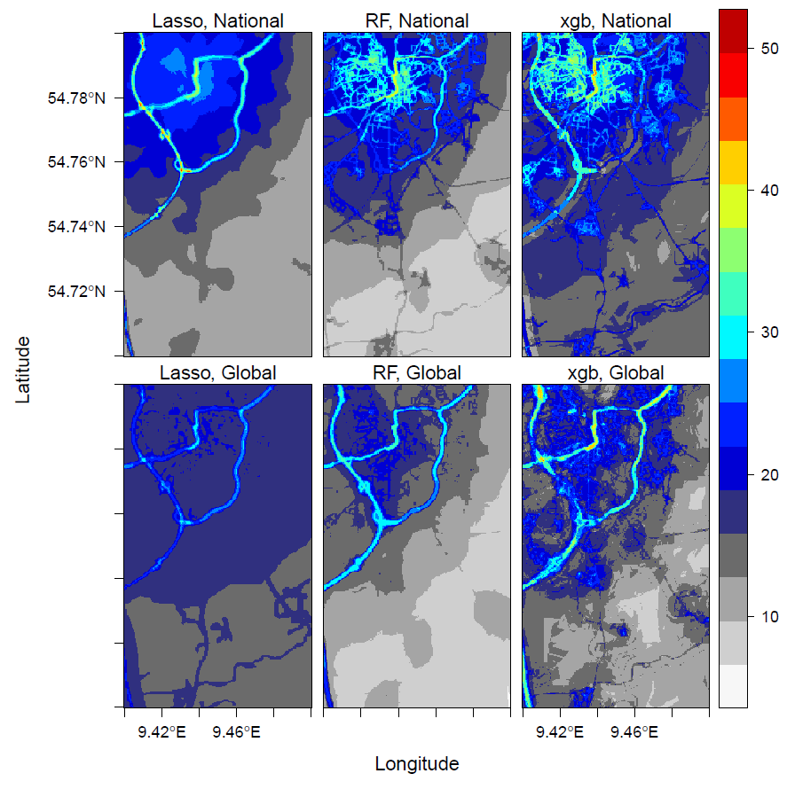
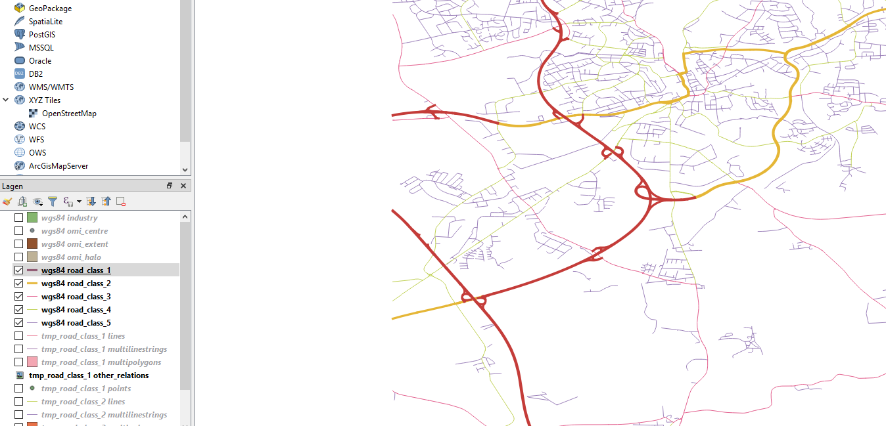
Germany
highway
primary

Slide 27
Important emition-related variables
National model of Germany
Ranked top 20 by Random Forest Primary road 25m, 50 m, 100 m Local road 25m, 50 m, 100 m, 300 m Ranked top 20 by XGBoost Primary road 50 m, 100 m Highway 50 m Local road 25m, 50 m, 100 m, 300 m Selected by LASSO Primary road 25m, 50 m, 100 m Highway 50m, 100 m Local road 100 m, 300m
Global model
Ranked top 20 by Random Forest* Primary road 50 m, 100 m Ranked top 20 by XGBoost Primary road 50 m, 100 m Highway 100 m Local road 25 m, 50 m, 100 m Selected by LASSO Primary road 50 m, 100 m Highway 50 m, 100 m Local road 25 m, 50 m, 100 m
*Highway 100 m ranked 26

Slide 28
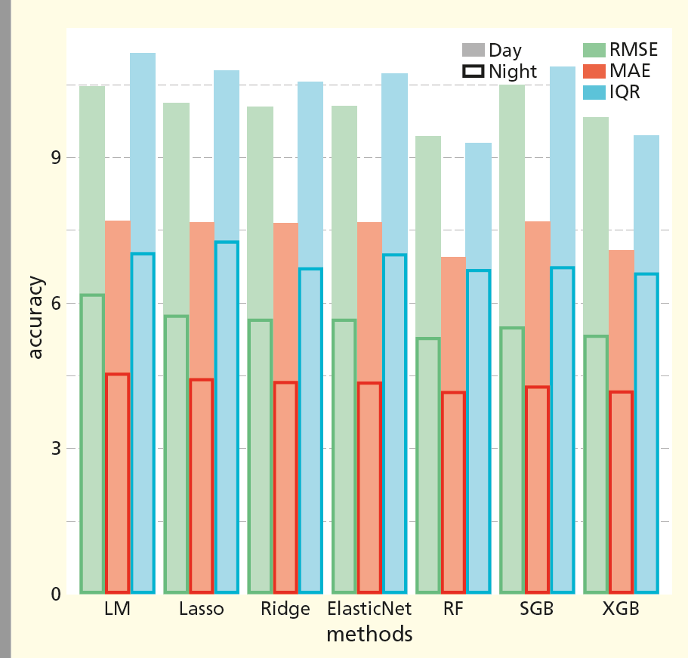
Germany
RMSE: root mean squared error
MAE: mean absolute error
IQR: interquartile range
LM: Multiple linear regression
RF: random forest
SGB: Stochastic gradient boosting
XGB: xgboost

Slide 29
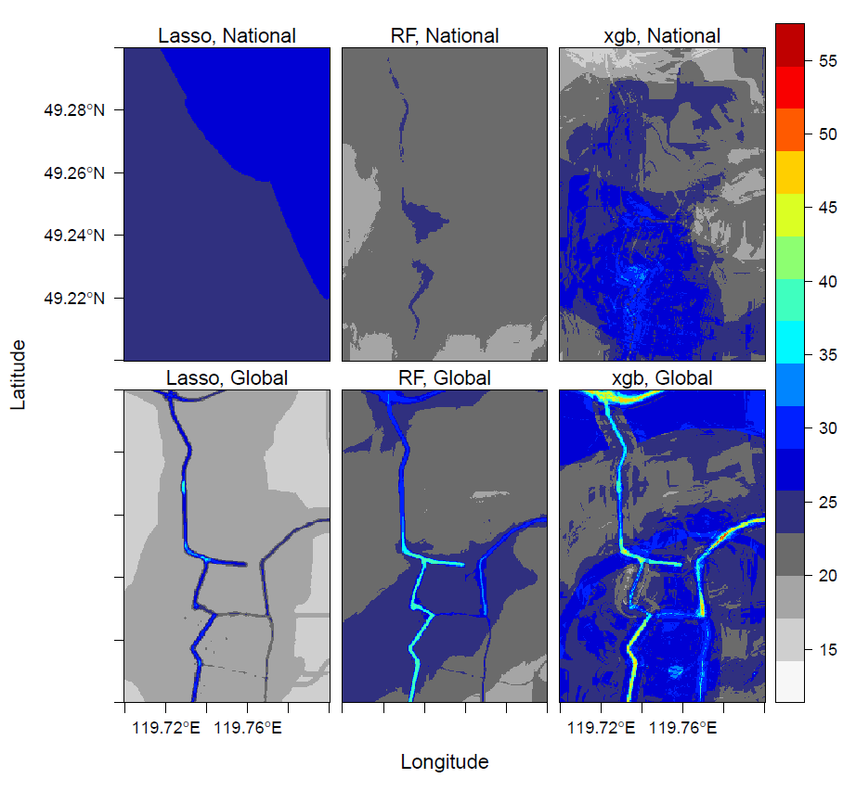
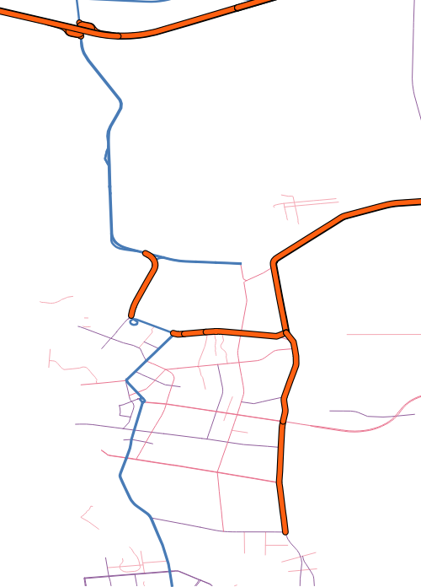
Prediction from different methods
emission-related variables
primary
highway
xgb: xgboost
RF: random forest

Slide 30
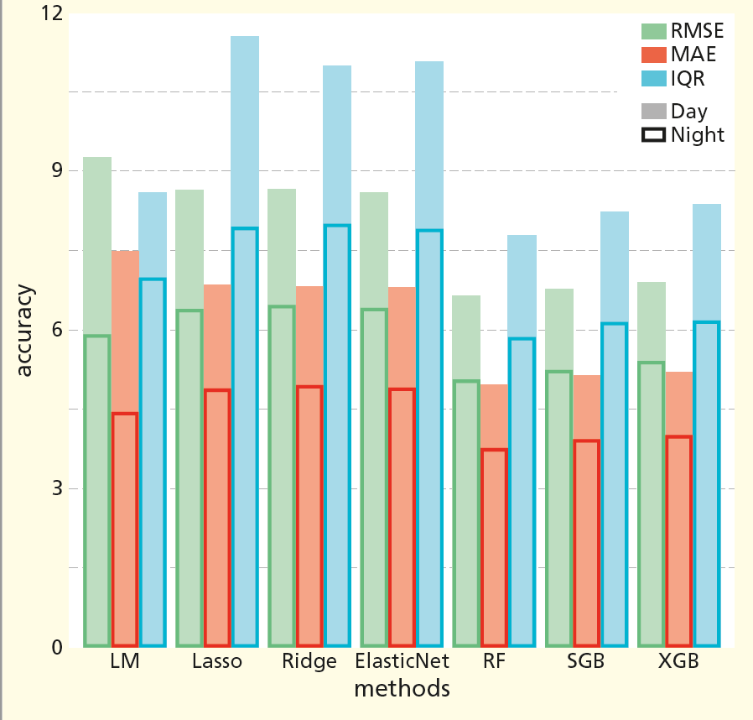
China
RMSE: root mean squared error
MAE: mean absolute error
IQR: interquartile range
LM: Multiple linear regression
RF: random forest
SGB: Stochastic gradient boosting
XGB: xgboost

Slide 31
Conclusion
The validation results indicate that tree-based methods are more suitable than Lasso for a global NO2 maping and their global models can achieve an accuracy as good as national models.
The differences in validataion accuracy between statistical learning methods are small.
The patterns of spatial predictions using different methods are notably different.
Field tracking measurements may be needed for validation.

Slide 32

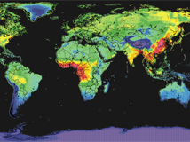
Thank you

Slide 33
[1] Shaddock et al., 2018: Environ. Sci. Technol.201852169069-9078
[2] https://www.theguardian.com/sustainable-business/2016/jul/05/how-air-pollution-affects-your-health-infographic
[3] http://www.tropomi.eu/sites/default/files/files/agu_veefkind.pdf

Slide 34
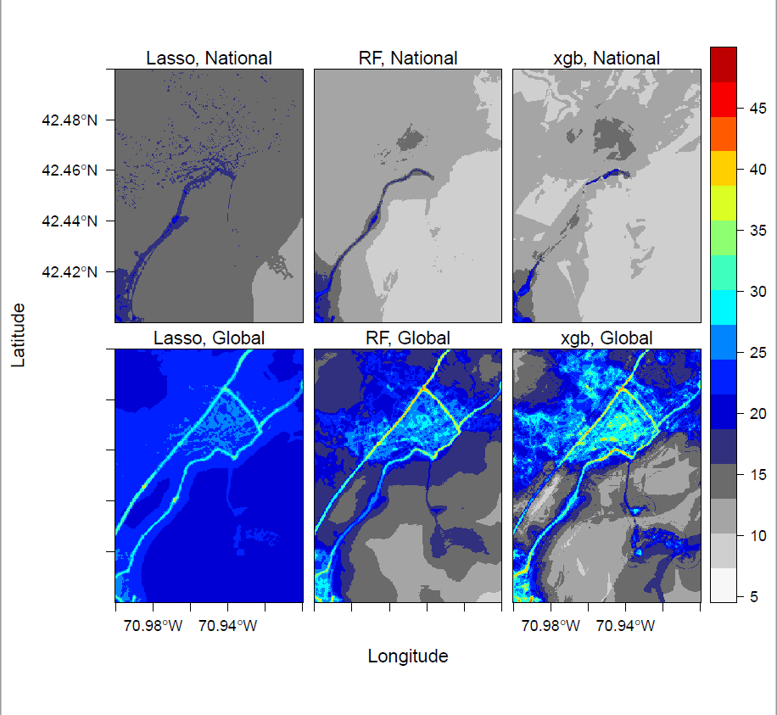
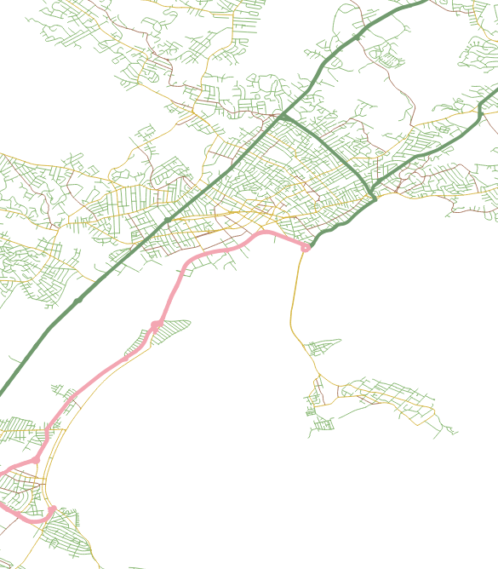
US
primary
highway

Slide 35
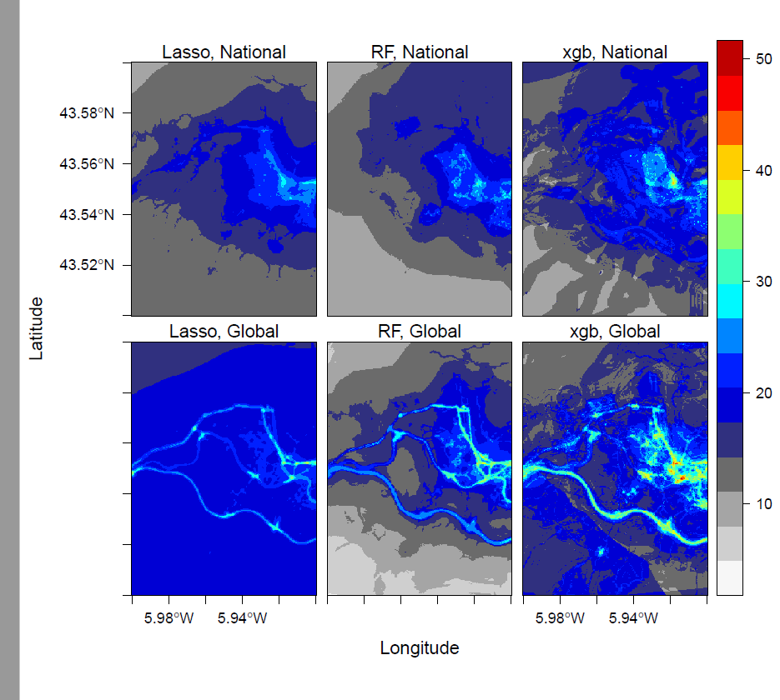
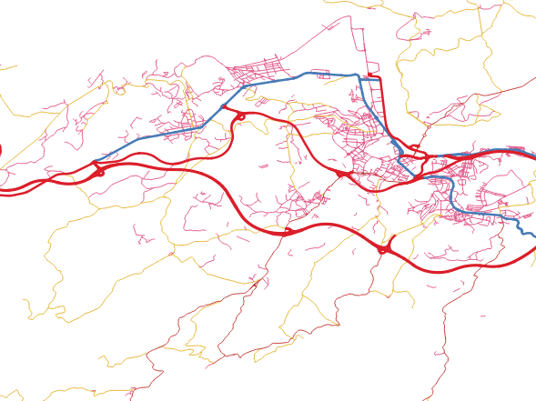
Prediction: Spain
primary
highway

Slide 36
China
RMSE: root mean squared error
MAE: mean absolute error
IQR: interquartile range
LM: Multiple linear regression
RF: random forest
SGB: Stochastic gradient boosting
XGB: xgboost

Slide 37
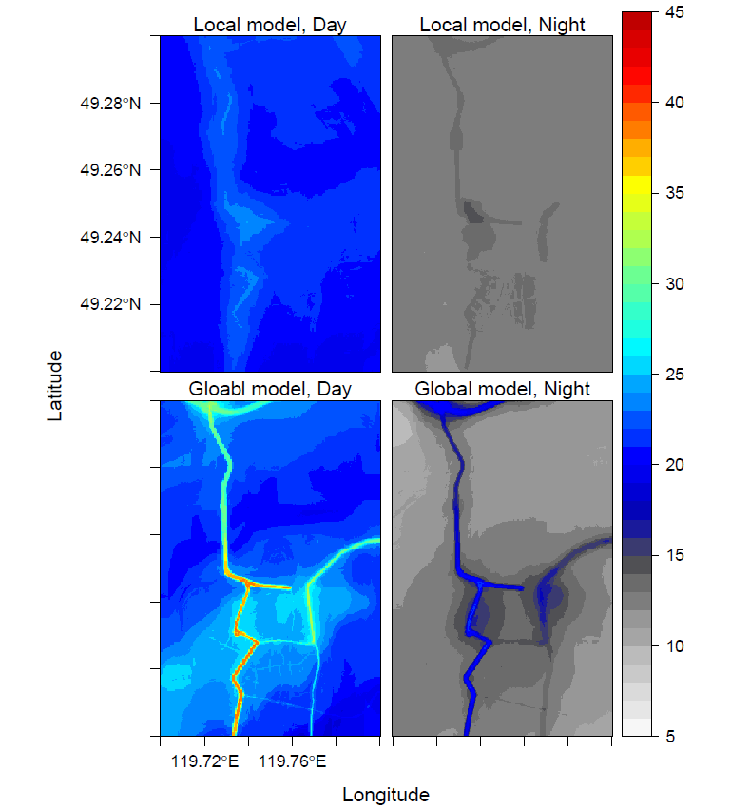

Random Forest
Prediction: China
primary
highway

